Slide 1
PROJECT BASED LEARNING-I PROJECT-II : PACKING GAME
by
Mustafa Onur DURKAL
Oral Denizhan MISIROĞLU
Mustafa Onur ŞARBAK

Slide 2
OUTLINE
INFORMATION
GAME RULES
PROBLEMS ENCOUNTERED
ALGORITHMS AND SOLUTION STRATEGIES
SCREENSHOTS

Slide 3
INFORMATION
The aim of the project is to develop a
two-player packing game.
Human plays against the computer.
The one who has the highest score in 60 seconds wins the game.

Slide 4
Randomly generated 12 blocks for both players
Box 0:
A,B,C,D,E,F,G,H,I,J,K,L
for HUMAN player
Box 0:
A,B,C,D,E,F,G,H,I,J,K,L
for COMPUTER player

Slide 5
GAME RULES
Each player has 3 boxes : Box1, Box2, Box3.
Each box size is 20 squares.
If a block doesn’t fit into a box, cannot be placed in that box.
HUMAN COMPUTER

Slide 6
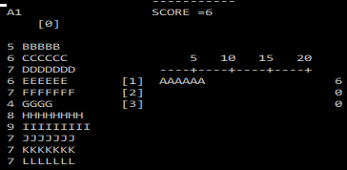
Human player uses commands to transfer blocks. Commands are 2 character:
The first character is the block name.
The second character is the box to be transferred.

Slide 7
The computer player places his blocks into boxes randomly.

Slide 8
PROBLEMS ENCOUNTERED
Our first problem is which is second input must to locate first input near.
We have to define box1,2,3 index and we did it.
We have to define box0 to two dimention array.
We have to carry blocks for human command
Threads were a big problem for us and we research threads on internet to learn sth.Than we used them but we have a little bit problems with threads.
Also blocks shifting was another encountered problem.

Slide 9
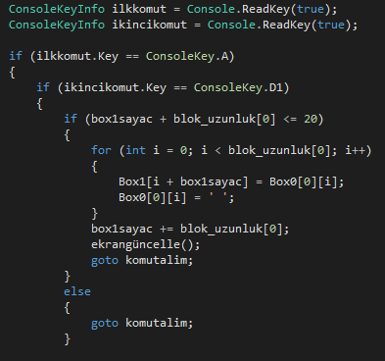
If a block doesn’t fit into a box, cannot be placed in that box.

Slide 10
PROBLEMS ENCOUNTERED
Another problem is blocks can come back to Box0 which is certainly complex because when a blocks come back the other neightbour blocks must slide to the left.

Slide 11
ALGORITHMS AND SOLUTION STRATEGIES
Firstly we define a time method (using loop) and used thread (sleeep(1000) for 1 second.)
Than we define windowsize with using command.
(Console.SetWindowSize(100, 30))
And we printed a interface which is never change in game with using setcursorposition.
Thats our first method(interface).
Than we define a gameplay method to inside blocks and using command .

Slide 12
ALGORITHMS AND SOLUTION STRATEGIES
İn gameplay method; we define boxes.
Box 0= 2 dimentional jagged array;
Box 1,Box2,Box3=1 dimentional array (lenght=20)
Using loops and box0 index assigned letters.
Than human enter a commands (which is using readkey)
And Box 0 letters carried box1,box2 or box3.

Slide 13
ALGORITHMS AND SOLUTION STRATEGIES
How can we carried letters.
Using loops and Box 0 index equalized Box1 index in according with command.
Than Box 0 index equalized null char.

Slide 14
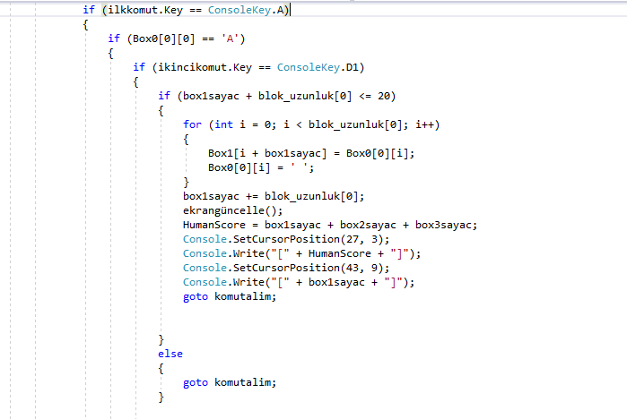
ALGORITHMS AND SOLUTION STRATEGIES

Slide 15
ALGORITHMS AND SOLUTION STRATEGIES
And if user input 0 command like A0;
Than we scan all boxes (Box1,Box2,Box3)
And carried come box0 index to same equalization.
But problem is shifting.
Box 1 A letter whıch ıs choosen is equalize A lenght next index.
Than we clear a last index with using array.clear method…
Also we holding a score variables in this method…

Slide 16
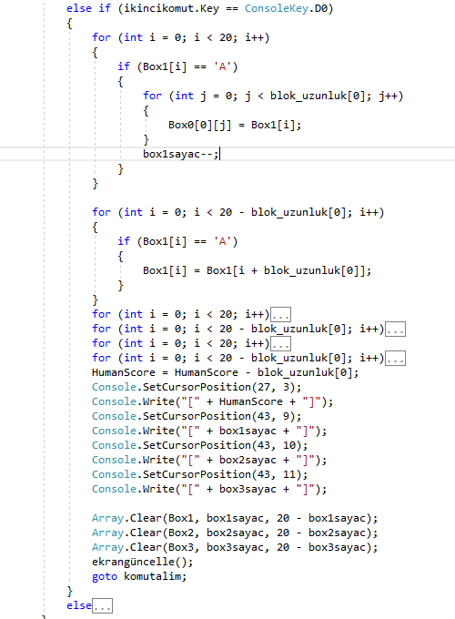
ALGORITHMS AND SOLUTION STRATEGIES

Slide 17
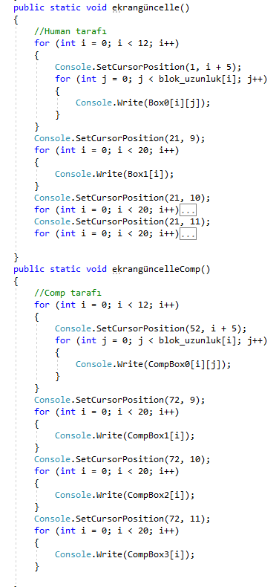
ALGORITHMS AND SOLUTION STRATEGIES

Slide 18
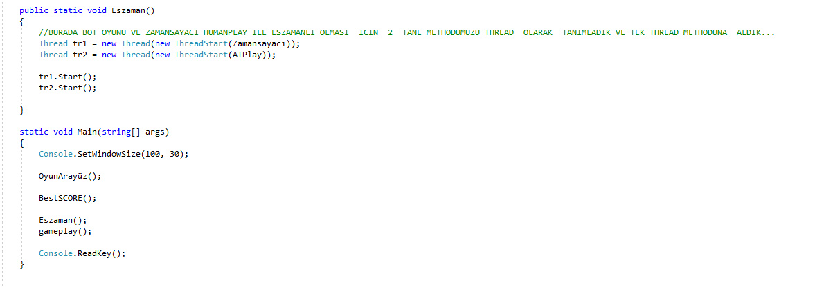
ALGORITHMS AND SOLUTION STRATEGIES

Slide 19
ALGORITHMS AND SOLUTION STRATEGIES
Third method is computerplay;
İts similar code a humanplay a there is a little differences.
First this method must define a thread.Cause of always playing with time.
Second command must be random (random method using)
Third Bot has a command for good score.if One box is insist 14 or more character bot never use back command…

Slide 20
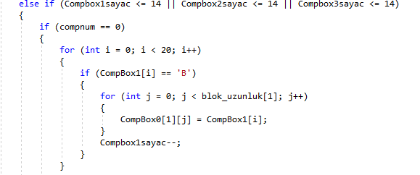
ALGORITHMS AND SOLUTION STRATEGIES

Slide 21
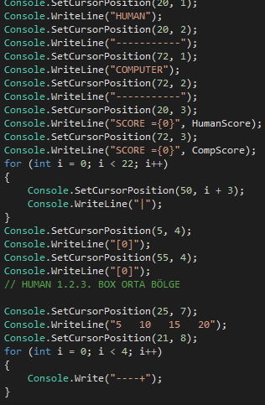
Game interface’s algorithms

Slide 22
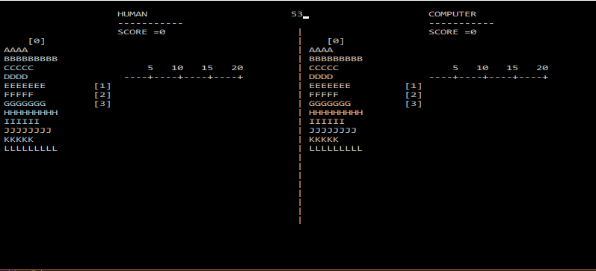
SCREENSHOTS Game Interface

Slide 23
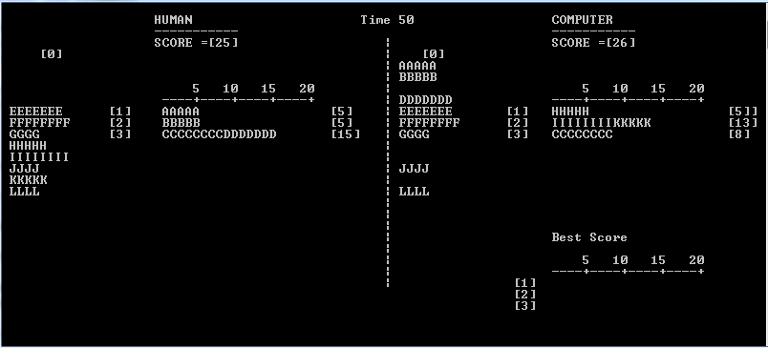

Slide 24
THANKS FOR LISTENING ☺

